Slide 1
INDUSTRIAL PROJECTS
DESIGN OF 6000A BUS DUCT IN VERTICAL CONFIGURATION
6000A BUS DUCT TERMINATING TO MAIN PCC III
6000A BUS DUCT WITH EXPANSION JOINTS

Slide 2
INDUSTRIAL PROJECTS
GLANDS PLATES FOR OUTGOING CABLES AS PER THE CABLE NOS.
BLACK POWDER COATED BUS EXTENSIONS TO THE MAIN BUS.
BLACK POWDER COATED BUS WITH SUPPORTS TO WITHSTAND SHIRT CIRCUIT OF 50KA.

Slide 3
INDUSTRIAL PROJECTS
MAIN POWER CONTROL CENTRE III FOR 2500KVA TRANSFORMER CENTRE
MAIN POWER CONTROL CENTRE III COUPLED TO EXISTING POWER CONTROL CENTRE II

Slide 4
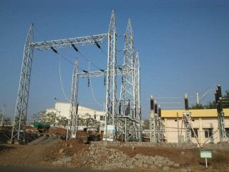
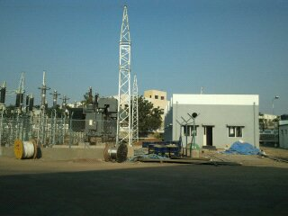
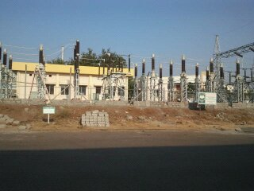
INDUSTRIAL PROJECTS
132KV SENDING BAY – 220/132KV SUB STATION
132KV NARROW BASED TOWERS
132KV RECEVIING STATION IN SCHREIBER DYNAMIX DAIRY
132KV HT METERING ROOM – MSETCL
33KV HT DISTRIBUTION ROOM.

Slide 5
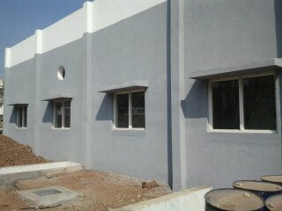
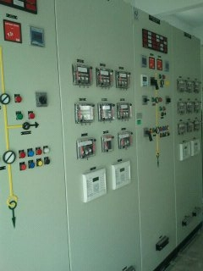
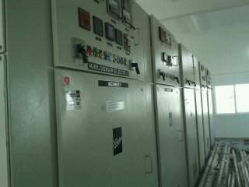
INDUSTRIAL PROJECTS
MAIN HT ROOM
TANSFORMER RELAY PANELS
33KV VCB OUTGOINGS -2NOS
BUS COUPLER

Slide 6
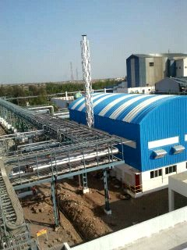
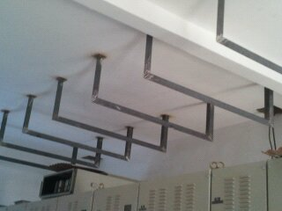
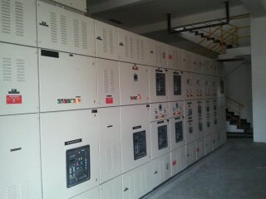
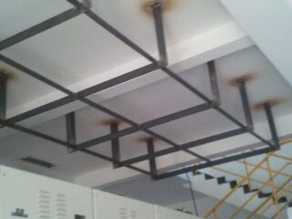
INDUSTRIAL PROJECTS
PCC – I AND II POWER HOUSE
PMCC ROOM AND LIGHTING DISTIBUTION PANELS
CABLING THROUGH FOOD INDUSTRY GRADE CABLE TRAYS
IP65 PROTECTED DISTRIBUTION BOARDS
20MTRS. HIGH MAST LIGHTING
EXTERNAL LIGHTING
INSERT PLATES DURING SLAB CASTING TO AVOID LATTER HASSLES OF CABLE TRAY FITTING.

Slide 7
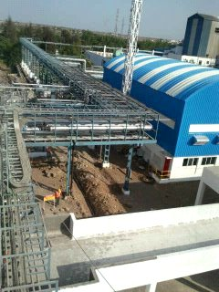
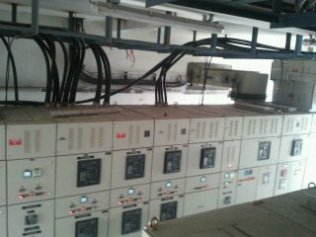
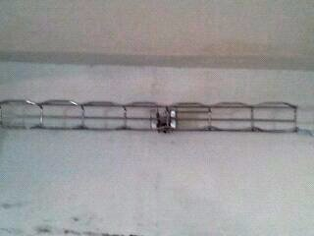
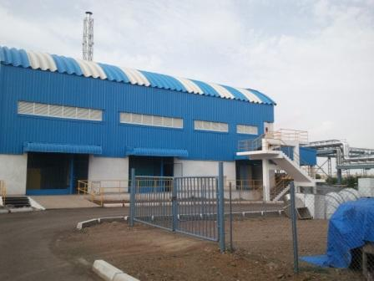
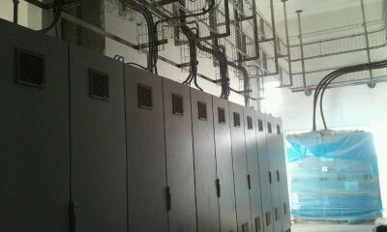
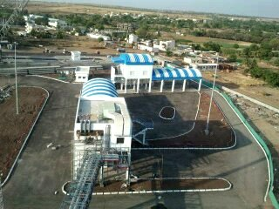
CABLE TRAY LAYOUTS
MAIN PANEL IN UTILITY
SS CABLE TRAY
INSTALLATION
UTILITY BLOCK
LIGHTNING MAST
MCC PANELS

Slide 8
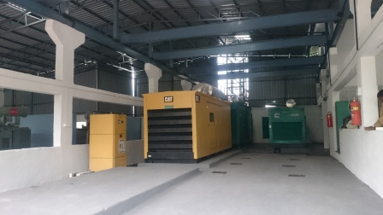
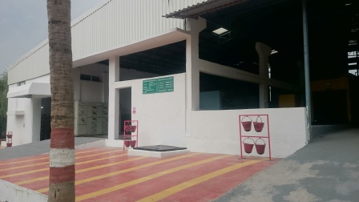
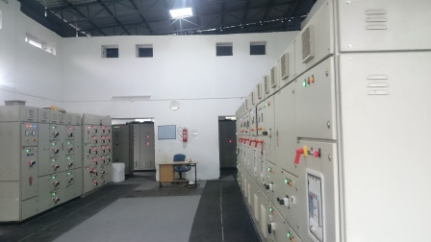
INDUSTRIAL PROJECTS
DG SETS – 750 AND 500KVA
UPGRADED POWER HOUSE
PCC ROOM

Slide 9
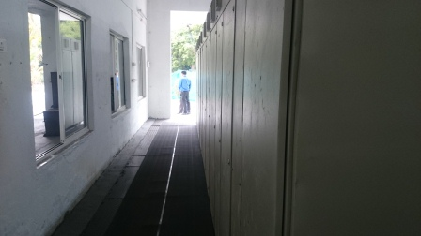
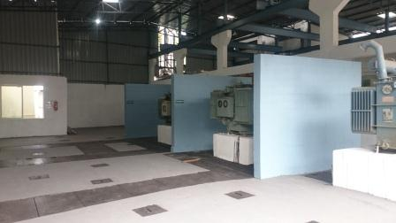
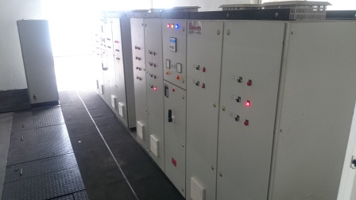
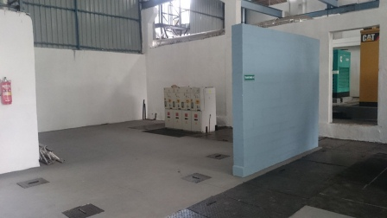
INDUSTRIAL PROJECTS
MARGINS FOR MAINTENANCE
TC–750KVA-3NOS (1-STD BY)
APFC PANELS FOR PCC 1 & 2
HT RMU – 1-I/C, 3-O/G

Slide 10
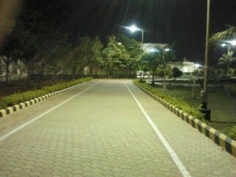
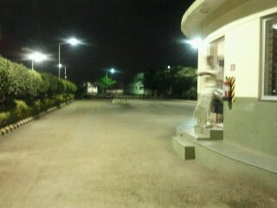
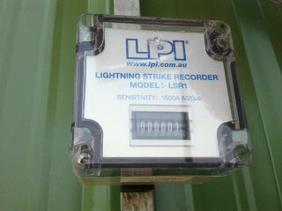
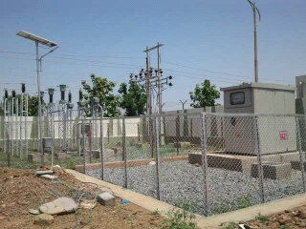
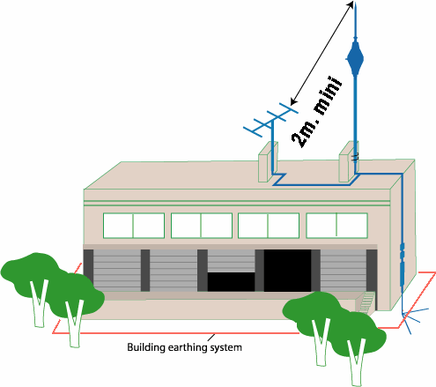
INDUSTRIAL PROJECTS
MAIN ENTRANCE
LIGHTNING COUNTER
MAIN VCB AND 33KV SS

Slide 11
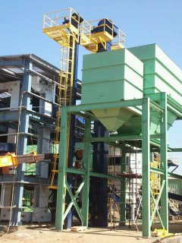
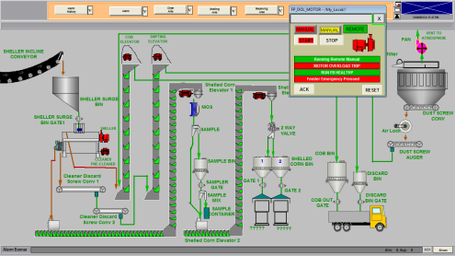
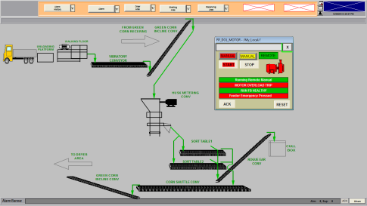
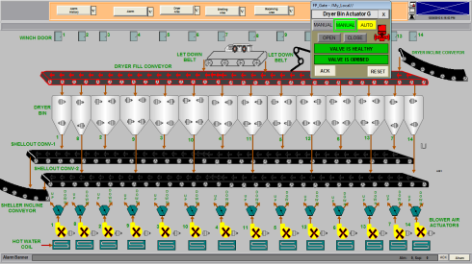
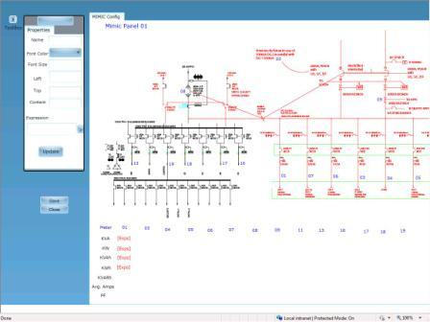
INDUSTRIAL PROJECTS
EXPANSION OF DRYER-1, CLD STORAGE-1
EXPANSION OF DRYER-2 , CLD STORAGE-1
AUTOMATION OF MCC AND FIELD DEVICES USING SCADA USING PLC PANELS
MIMIC OF MAIN PANEL SLD FOR MONITORING OF THE PARAMETERS
TRANSFORMER CAPACITY INCREASED FROM 500KVA TO 1500KVA

Slide 12
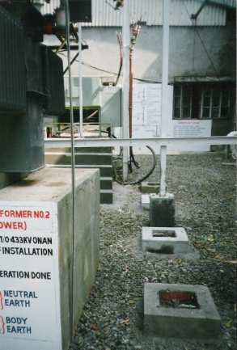
INDUSTRIAL PROJECTS
DESIGN OF 11KV HT SUBSTATION – 315KVA, 2NOS. OF TC. A. POWER TOOL DIVISION
B. BLOWER DIVIDION
Proper sizing of the TC plinth.
Chambers for the Earth pits.
SLD of the system

Slide 13
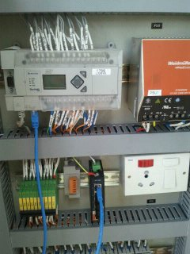
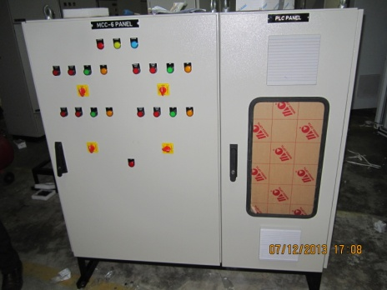
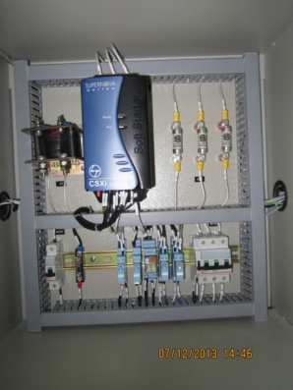
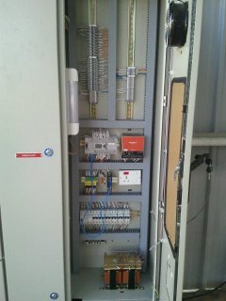
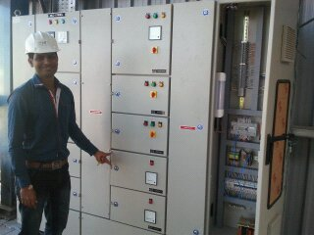
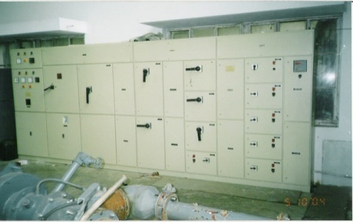
INDUSTRIAL PROJECTS
MAIN METERING – MULTI PARTY SCHEME – WEAVING UNITS IN ICHALKARANGI.
MCC AND PLC PANEL WITH VFD AND PROVISION OF MCB TRIPPED INDICATION
BLOWER DIVISION MAIN PANEL WITH CHANGE OVER AND APFC

Slide 14
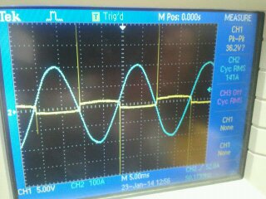
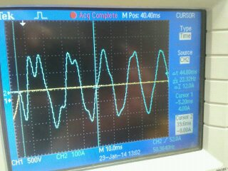
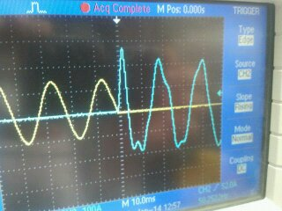
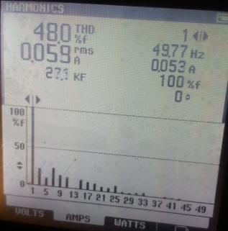
APFC PANEL WITH 7% DETUNED REACTOR THYRISTORIZED SWITCHING AND WAVEFORMS
ADDRESSING HARMONICS PROBLEMS
CONFIRATION OF ZERO CROSSING OF THE THYRISTOR BASED APFC PANELS
DIFORMATION OF THE WAVEAND STABILZATION AFTERR NUMBEROF CYCLES CONFIRMATION.
SPIKES AT THE INSTANT OF SWITCHIN ON THE CAPACITORS.
CONFIRMATION OF HARMONICS IN LED LOW BUDGET (UNBRANDED) LIGHT FITTING

Slide 15
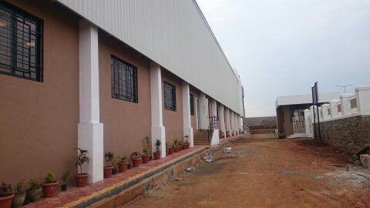
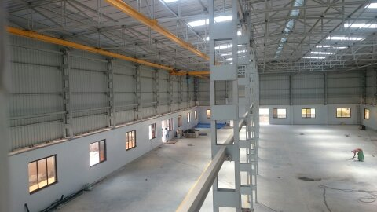
INDUSTRIAL PROJECTS
CABLE TRAYS LAID TO MINIMIZE THE RUNNING

